Slide 1
FHIR Implementation Guide Creation Training
September 11-12, 2019

Slide 2
Your FHIR IG Tutorial Team
Nagesh (Dragon) Bashyam
Senior Architect and Advisor for Drajer LLC having worked on FHIR, C-CDA, and QRDA I&III. Created many FHIR IGs including US-Core and DAF-Research.
Sarah Gaunt
Senior Information Analyst with Lantana Consulting Group, involved with HL7 standards since 2006, in the UK, Australia, and USA. Have authored many, many CDA IGs and several FHIR IGs.
David Pyke
Jack of all trades for Ready Computing, CBCP co-chair, trained facilitator and project manager, FHIR IG writer and resource owner

Slide 3
Your FHIR IG Tutorial Team
Lloyd McKenzie
Senior consultant w/ Gevity. Author of 15+ FHIR IGs and committer for the IG Publisher. Have been doing healthcare IT for 20 years and involved w/ FHIR since before it was FHIR.
Melva Peters
Co-Chair of the Pharmacy Work Group, International Council and Clinical Steering Division, Technical Steering Committee (TSC) and is the Secretary of the HL7 Board. FHIR Implementation Guide Facilitator for HL7.

Slide 4
Agenda
Wednesday:
What is an IG?
Profiling
Discuss questions from videos
Hand-authoring using XML
Hands-on exercises
Managing, Debugging and QA

Slide 5
Agenda
Thursday:
Working the HL7 process
Community Building
Source Control
Vocabulary Overview
FHIR IG Structure and Organization
Quality
Open discussion

Slide 6
What is a FHIR Implementation Guide?
“An implementation guide (IG) is a set of rules about how FHIR resources are used (or should be used) to solve a particular problem, with associated documentation to support and clarify the usage.”
A set of constraints on FHIR resources, value sets and supporting information to solve a use case. It may also include customized operations.
Why do we need them?
“The [FHIR] specification focuses on defining capabilities and creating an ecosystem. National standards, vendor consortiums, clinical societies, etc. publish "implementation guides" that define how the capabilities defined by the FHIR specification are used in particular data exchanges, or to solve particular problems.”

Slide 7
What is a FHIR Implementation Guide
Implementation Guides contain two different types of resource references:
Contents: A set of logical statements which implementations must conform to. These are almost always conformance resources such as Resource Profiles and Value Sets/Code Systems
Examples: Examples that illustrate the intent of the profiles defined in the implementation guide. These can be any kind of resource
An application's Capability Statement may identify one or more implementation guides that an application conforms to.
They will also have prose, graphics and logical models to help the Implementer and user of the IG

Slide 8
Using Forge
Pros:
Updated directly on launch
Fully compliant with DSTU2 - R4 (separate downloads)
Imports into Simplifier.Net and directly to a FHIR server
Edit direct on your local system (not a web application)
Cons:
Creates Sparse Differentials
Must have local copy of dependent profiles in subdirectory
Currently doesn’t allow underscores in name (which is legal)

Slide 9
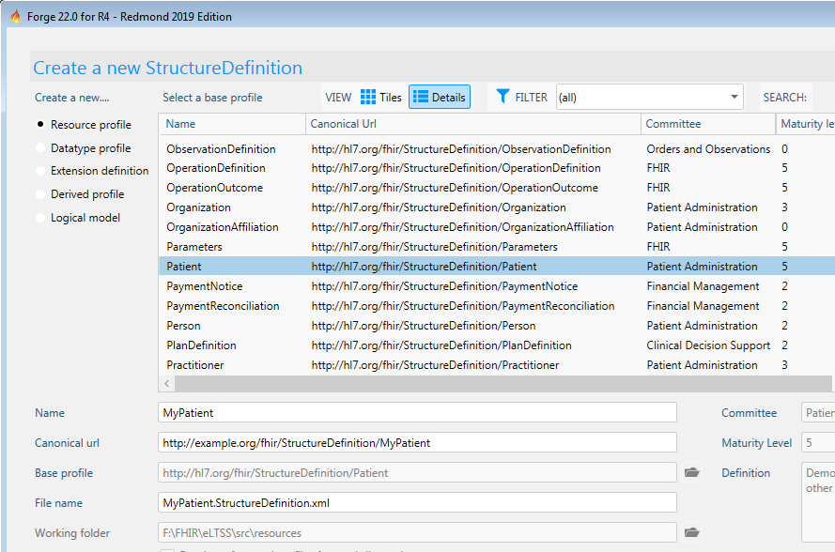
Using Forge
Select your base resource or profile

Slide 10
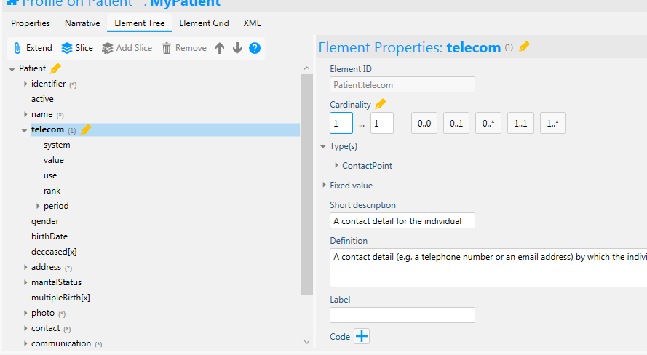
Using Forge
Modify the constraints

Slide 11
Community Building
It’s not just about the code

Slide 12
Building Community
Building a FHIR IG isn’t just about creating the profiles and text, it has to solve a problem in a way that works. Even if it is technically perfect, it can still be wrong if it doesn’t solve the needs of the community in a way they can use it.
All stakeholders, not just the sponsors, need to be part of the community and need to be heard.
Sponsors are a good link to appropriate groups that will be a part of your community

Slide 13
Building a community
Your FHIR IG’s community can be huge or small, depending on the use case.
Find the stakeholders and get them involved though meetings, surveys, email, any form of communication.
Facilitated meetings are the best way to get all issues on the table and move the process forward.
Find out key requirements versus needs versus nice-to-haves
What needs to be profiled versus what needs to be documented
What is urgent versus what’s considered for future use

Slide 14
Zulip – chat.fhir.org
If you haven’t signed up, do it now. We’ll wait.
Join the #IG Creation, #committers/notification and which ever others hold your interest (hint, hint, #committers/git-help)
Answers to your issues and identifying “undocumented features” of the toolset that arose from Grahame’s last commit can be found there.
Often the exact issue that you’re facing is or has been found and/or solved by someone there.
Don’t be afraid to ask stupid questions, people there are able to help.
Also, many members of your community are there. There are roughly 100 channels already and you can make one if you haven’t found yours.

Slide 15
Working with HL7 Work Groups
One of the ways to build a community is through the appropriate work groups.
Work groups are a representation of those who work with and in a specific community and/or subject area.
a great source for subject matter experts, process experts and representatives of your community
can review your use case, documentation, content problem solving ideas
can also throw needless roadblocks if they don’t understand your use case and/or have an agenda.
Using the mailing list or getting your IG on the meeting agenda for a teleconference.

Slide 16
The Author’s Role
The IG Author(s) will be seen as the experts in what can be done and how to make it all happen.
Nail down the scope of the IG as tightly as possible at the start.
The Author(s) need to make the process smooth by helping to facilitate discussions on the possible, impractical and impossible and correctly label each.
ASK QUESTIONS but phrase them carefully.
Offer alternatives to the impractical and impossible, refine the possible
If the author doesn’t understand it, then it’s going to be done wrong.
ASK QUESTIONS but phrase them carefully.

Slide 17
Getting to Yes, or No
The biggest problem in building a use case solution is limiting what needs to be done. That means prioritizing and sometimes saying “No”. But only sometimes
Easy “No”s are that which is technically impossible. Everything else is negotiable
Is that request urgent, needed or nice to have?
Is that needed now, or can we worry about that in the future
Can we put a note in the documentation instead of constraining it?

Slide 18
It’s All About Time
Prioritization is also about setting and meeting timelines. A four-year project to create version 1 of an IG is a waste of life.
What’s a reasonable timeline? – How big is it?
How many profiles, extensions, codesets, examples? How much can be re-used/borrowed?
How much research?

Slide 19
It’s All About Time
What’s a reasonable timeline? – How big is it? (cont’d)
How much explanatory text?
How many diagrams?
All of this takes time. All of this takes resources to create.
Authors , modellers, SMEs, reviewers, vocabulary, etc.

Slide 20
Use of Connectathons
“An HL7 [FHIR]Connectathon is a two-day event of hands-on FHIR development and testing held in conjunction with Working Group Meetings.”
Once you have a working prototype, the FHIR Connectathon is the best way to put it in front of parts of the community and see where the holes are.
Find a/some member(s) of the community who can be partners for the test
New issues, other points of view, new eyes on a tricky issue all become more apparent than working in isolation

Slide 21
Comment Ballots
With a Connectathon test achieved, and the issues cleared up, it’s time to let the whole community have a look.
Submit a Notice of Intent to Ballot and go through the publication readiness checklist to get all the supporting paperwork done
Package-list.json
Properties.txt
A perfectly clean (or at least only issues for Grahame left) QA result
A fresh, clean IG is then pushed to the HL7 FHIR repository.

Slide 22
Comment Ballots
Invite as many as possible to review the IG as in depth as possible and submit detailed comments
Sit and watch as the community calls your baby ugly.
Comments come in three flavours:
Typo – tend to be automatically accepted
Affirmative – suggestions, questions or comments that the commenter feels would improve or clarify the content
Negative – changes the commenter feels must be made to make the IG suitable for use.

Slide 23
Comment Resolution
In-person resolution at the following WGM is best. However, discuss prior with negative commenters with negotiated solutions
Follow the easy-to-use steps to get all your ballot comments into GForge (or, someday, Jira):
Review all comments and, with the project team, create suggested dispositions (solutions) for each.
Suggested dispositions are suggestions. They might not be what the commenter wants so some negotiation is needed.
“Not Persuasive” should be used only when the comment is impossible. Otherwise, find a negotiated solution. That may include “Considered for Future Use”
Affirmative comments need only be considered, they do not require action.
Some comments may be enough to make your change your model (resource choices, etc.). That usually requires another comment ballot.

Slide 24
Source Control

Slide 25
Version Management
There are several versions you need to manage:
The FHIR version you’re using as your base
The version of your IG (less than 1.0 at the start)
(optionally) the version of IG you’re dependent on (USCore)
You don’t need to worry about the FHIR version, except to list it in your ImplementationGuide resource
USCore (if you’re dependent) has different versions based on FHIR version and may be revised. It’s important that you track it’s version as it may break your build with a change if you’re working from the CI version.

Slide 26
Version Management
Your IG’s version is dependent only on your development. Typically, you’ll use 0.1.0 as your development and initial comment period version, specifying that you’re in-progress and things are ready to change.
Your second comment ballot version is 0.2.0, and so on.
When you’ve done all your balloting and comment resolution, then you hit version 1.0 for STU 1
When you update it for STU 2, or beyond, you’re at 2.0, etc.
Revisions for STU updates are 1.1, etc.

Slide 27
The FHIR Maturity Model (FMM)
FMM1 = no warnings during the build process and the responsible WG has indicated that they consider the artifact substantially complete and ready for implementation.
The FHIR Management Group has approved the underlying IG proposal.
FMM2 = tested (e.g. at a Connectathon) successfully among at least three independently developed systems using semi-realistic data and scenarios
FMM3 = verified by the work group as meeting the Conformance Resource Quality Guidelines;
has been subject to a round of formal balloting
at least 10 distinct implementer comments from at least 3 organizations resulting in at least one substantive change

Slide 28
The FHIR Maturity Model (FMM)
FMM4 = tested across its scope, published in a formal publication (e.g. STU), and implemented in multiple prototype projects.
the responsible work group agrees the IG is sufficiently stable to require implementer consultation for subsequent non-backward compatible changes.
FMM5 = the artifact has been published in two formal publication release cycles at STU level and has been implemented in at least 5 independent production systems (in multiple countries if not US Realm)
FMM6 = the responsible work group and the FMG agree the material is ready to lock down and the artifact has passed HL7 normative ballot

Slide 29
GitHub
Please sign up for GitHub and let the FMG know your GitHub username so you can work in the FHIR space
To do this, just send a message to the "GitHub Usernames" stream of #committers listing your username
Download and install a Git client for your operating system
Check in (“Push”) your current code base

Slide 30
GitHub Issues
Working with Git is a challenge at times, if you have multiple committers. If you do need to have multiple people working on the project, there are two ways to handle this.
You have sole committer access, people send you the files they are adding, you review and push them into the build.
You maintain branches and merge manually
Some think one is best as you don’t end up (frequently) with mystery breakages due to uncommunicated changes.
Using Git/GitHub version control allows you to roll back changes that break your build or were committed accidentally.
Always pull the latest version of the code base before branching if you’re working with multiple developers.

Slide 31
Setting Up the CI Build Process
Create an IG in a new GitHub folder, including a file called ig.json containing the IG definition, alongside any other content that your IG requires.
Configure the Webhook (next slide)
Now GitHub will automatically trigger a build whenever you commit changes.
It can take 2-3 minutes for the build and you will see a notification in Zulip in committers/notifications/ig-build
https://fhir.github.io/auto-ig-builder/builds.html shows the status of all IG CI builds and allows triggering a re-build.

Slide 32
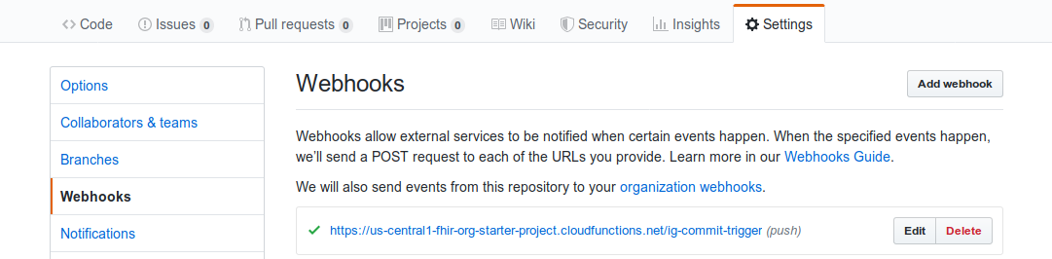
Adding the Webhook
Add a Webhook in GitHub: click "Settings", then "Webhooks", then "Add Webhook".
Enter the URL: https://us-central1-fhir-org-starter-project.cloudfunctions.net/ig-commit-trigger.
Choose "Content type" of application/json
Accept the default (empty) "secret".
Choose "Just the push event" as the trigger,
Click "Add webhook".
1
3
2

Slide 33
Vocabulary

Slide 34
Internal vs. External Code Systems
FHIR Code systems define the codes used for standard value sets used in the Profiles
External such as RxNorm, SNOMED, LOINC, etc.
FHIR Internal (FHIR Created) all prefixed with http://hl7.org/fhir/
FHIR External (FHIR licensed or imported) all prefixed with http://terminology.hl7​.org/CodeSystem/
HL7 V3 using http://terminology.hl7.org/CodeSystem/v3-[Name]
HL7 V2 using http://terminology.hl7.org/CodeSystem/v2/[Table]
Where possible, using HL7 code systems simplifies matters but may not cover your use case.

Slide 35
A reminder!
Always check to see if there is a code system or value set that meets your needs before creating your own.
Extend it or constrain as necessary

Slide 36
Using SNOMED CT with FHIR
SNOMED CT has two common sets of implicit value sets defined: By Subsumption, by Reference Set. Implicit value sets can also be defined using an expression constraint.
The implicit value set capability allows a single URL to serve as a value set definition and can serve as the basis for value set references.
If any value set resources exist with an identifier that conforms to URL patterns, the content of the resource must conform to the template provided. Profiles and other value set references can reference these value sets directly (by reference as a URI, rather than by a literal value set reference).
A SNOMED CT implicit value set URL has two parts:
The base URL is either http://snomed.info/sct , or the URI for the edition version, in the format specified by SNOMED International in the SNOMED CT URI Specification
A query portion that specifies the scope of the content

Slide 37
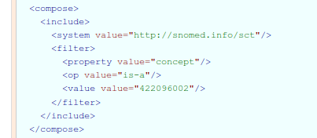
Subsumption
Includes all concept ids that have a transitive is-a relationship with the concept id provided as the value (including the concept itself)
For example: the Administration Methods subsuption is where concept is-a 422096002 (Dosing instruction fragment)
https://www.hl7.org/fhir/valueset-administration-method-codes.xml.html

Slide 38
By Reference Set
Includes all concept ids that are active members of the reference set identified by the concept id provided as the value
Syntax is the same except op value=“member of”

Slide 39
Using SNOMED CT with FHIR
The URL http://snomed.info/sct should be understood to mean an unspecified edition/version.
If no version or edition is specified, the terminology service SHALL use the latest version available for its default edition (or the International Edition, if no other edition is the default).
The recommended string template to use for a version (substituting in the appropriate module for {sctid} and {effective time}) is http://snomed.info/sct/{sctid}/version/{timestamp}
More information is at: https://www.hl7.org/fhir/snomedct-usage.html
Please note: don’t bind (meaning use extensible, required, etc.) if your IG is in the international domain. While countries like the US and Canada have a free license, many countries, in the EU and beyond do not.

Slide 40
SNOMED URIs
The URIs that identify (unversioned) Editions and Versions (i.e., versioned Editions) take the following respective forms:
http://snomed.info/sct/{sctid}
http://snomed.info/sct/{sctid}/version/{timestamp}
The SNOMED CT URI Guide contains additional discussion and guidance on this topic.
Search for the code(s) you need using the SNOMED browser (https://browser.ihtsdotools.org/ )
Examples
SNOMED CT International Edition http://snomed.info/sct/900000000000207008
SNOMED CT International Edition, 20130731 http://snomed.info/sct/900000000000207008/version/20130731
SNOMED CT-AU http://snomed.info/sct/32506021000036107
SNOMED CT-SE http://snomed.info/sct/45991000052106

Slide 41
Using LOINC with FHIR
The terms of use for LOINC require that a notice be included with any use of LOINC codes in the copyright element of the value set.
The URI http://loinc.org identifies LOINC codes
LOINC also allocates Answer List and Answer String Ids for use in forms and Questionnaires.
More information is at https://www.hl7.org/fhir/loinc.html
The LOINC browser is at https://search.loinc.org/ to find a code you need

Slide 42
LOINC Codes
LOINC Parts are a coded representation of a value for a dimension used to specify a LOINC Term which are assigned a non-semantic identifier with a "LP" prefix and a mod-10 check digit (e.g. LP31755-9). Following the LOINC license, these part codes may be used in the following ways:
In filter properties,
In Structure Definitions, where the structure describes the use of a set of LOINC codes
In a ConceptMap resource, where mappings between LOINC codes and other codes are being defined

Slide 43
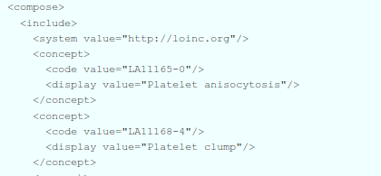
LOINC use in Questionnaires
LOINC allocates Answer List and Answer String Ids for use in various forms and questionnaires. LOINC Answer String IDs are also valid LOINC codes:
LOINC Answer List Ids are value set identifiers.

Slide 44
LOINC Properties
In addition to the standard properties, the following LOINC table fields are defined as code system properties when using LOINC in FHIR:
STATUS | string | Status of the term
COMPONENT | code | First major axis-component or analyte: Analyte Name, Analyte sub-class, Challenge
PROPERTY | code | Second major axis-property observed: Kind of Property (also called kind of quantity)
TIME_ASPCT | code | Third major axis-timing of the measurement: Time Aspect (Point or moment in time vs. time interval)
SYSTEM | code | Fourth major axis-type of specimen or system: System (Sample) Type
SCALE_TYP | code | Fifth major axis-scale of measurement: Type of Scale
METHOD_TYP | code | Sixth major axis-method of measurement: Type of Method
CLASS | string | An arbitrary classification of the terms for grouping related observations together
CONSUMER_NAME | string | An experimental (beta) consumer friendly name for this item. The intent is to provide a test name that health care consumers will recognize; it will be similar to the names that might appear on a lab report
CLASSTYPE | string | 1=Laboratory class; 2=Clinical class; 3=Claims attachments; 4=Surveys
ORDER_OBS | string | Provides users with an idea of the intended use of the term by categorizing it as an order only, observation only, or both
DOCUMENT_SECTION | string | Classification of whether this LOINC code can be used a full document, a section of a document, or both

Slide 45
LOINC Filters
LOINC Property filter using the LIONC properties (uses = or regex operations)
Third Party Copyright allowing for use of the inclusion or exclusion of LOINC codes that include third party copyright notices (uses the = operation)
Multi-Axial Hierarchy using codes based on parent/child relationships (uses the = or in operations)

Slide 46
Respecting IP
Use of External Code Systems must follow the guidelines for copyright and other restrictions
It is NEVER okay to use values from a code system without permission and/or attribution.
Most external code system you need are already in FHIR
If you need a Code system and there is not a code system definition setup via FHIR or terminology.hl7.org and you can’t use it via OID (urn:oid=OID) then it’s time to contact the HL7 Terminology Authority

Slide 47
HL7 Terminology Authority
“Terminology Authority - is responsible for the creation, implementation, and management of HL7 processes involving external terminology management. These processes shall be influenced by input from the Vocabulary Work Group and existing HL7 terminology practices.
The activities of the HTA are intended to complement maintenance of terminology that is used by HL7 protocol specifications. HTA works through the TSC to implement processes or polices that impact Working Groups”

Slide 48
HL7 Terminology Authority New Code Systems
First, open a GForge ticket requesting that Code System be added. Assign the Reviewing Work Group to be Vocabulary
Submit the HL7 Terminology Authority – Content Request form to the HTA, who will provide guidance.
HTA will review content and get back to you if there are any concern - this could be a cyclic process.
The approved form with HTA approval can then be submitted with your harmonization proposal.
Work with the work group vocabulary facilitator if you have questions.

Slide 49
What’s a CodeSystem
“The CodeSystem resource is used to declare the existence of a code system, and its key properties:”
Identifying URL and version (if needed)
Description, Copyright, publication date, and other metadata (as appropriate)
Some key properties of the code system itself :
concept permanence, compositional grammar, if the codes that it defines are case sensitive
What filters can be used in a ValueSet that references it
What concept properties are defined by the code system

Slide 50
What’s a CodeSystem
In addition, the CodeSystem resource may list some or all of the concepts in the code system, along with their properties and designations.
Code System resources may also be used to define supplements, which extend an existing code system with additional designations and properties.

Slide 51
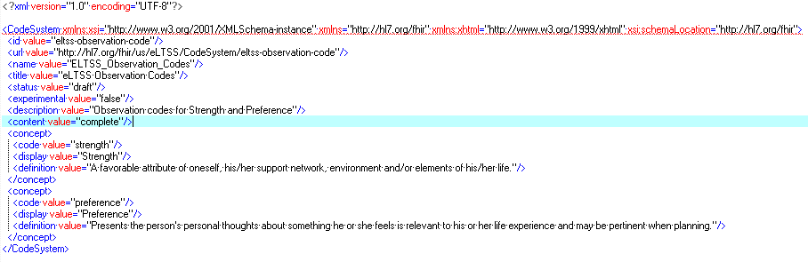
Code system definition example

Slide 52
Selecting ValueSet Concepts
Name the code system (with optional version if needed)
If including the code system, all codes are included by default
List specific codes from the system
With alternate descriptions, if needed
Select codes by property (‘filter’)
Property Name – defined by the code system
Operation – ‘=’, ‘is-a’, ‘in’, ‘regex’, etc.
Value – the value of the property
e.g., LOINC: COMPONENT = “Sodium”

Slide 53
ValueSet Concept Examples
Brings in all codes from the CodeSystem
<include>
<system value="http://hl7.org/fhir/us/core/CodeSystem/condition-category"/>
</include>
Includes only the specific code from the system you want
<include>
<system value="http://hl7.org/fhir/us/eLTSS/CodeSystem/eltss-condition-category-code"/>
<concept>
<code value="assessed-need"/>
<display value="Assessed Need"/>
</concept>
</include>

Slide 54
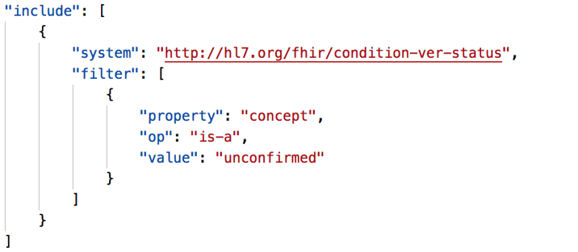
ValueSet Concept Examples
Uses a property filter to bring in all codes matching the value you specify

Slide 55
Creating your own ValueSet
As an Exercise, create a ValueSet for the Days of the Week
Constrain it to only have Monday through Friday, not including Wednesday as your use case is a physician that doesn’t work weekends and golfs on Wednesday.

Slide 56
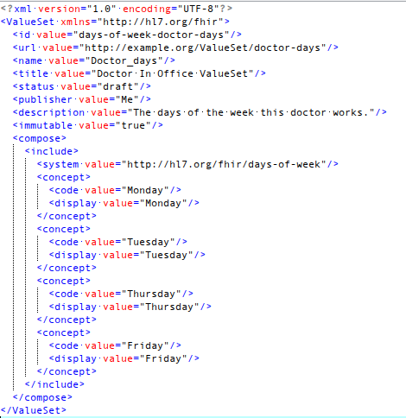
Exercise:
Don’t create a CodeSystem, FHIR already has one…
http://hl7.org/fhir/days-of-week

